Slide 1
Introduction to SATIM features, capabilities and applications
17 October
Online- Alison dialing in from Colorado USA

Slide 2
Introductions

Slide 3
IEP Objectives
2016 IEP (DMRE) | WWF IEP
Ensure security of energy supply ✓ | ✓
Minimise cost of energy ✓ | ✓
Minimise environmental impacts ✓ | ✓ (Paris Agreement aligned emission reductions)
Minimise water consumption ✓ | ✓
Promote energy efficiency ✓ | ✓
Promote energy access ✓ | ✓
Promote Job creation & localisation✓ | ✓ (as an output)
Diversify supply sources ✓ | ✕
Qualitative justice (as an output) ✕ | ✓
“we need some changes, things must change”

Slide 4
Session overview
Recap – energy systems models
TIMES overview
SATIM overview
Structure – how does SATIM depict the SA energy system
Methodology – how does SATIM model the energy system and how do we get the insights we need
Emissions
Data – what are we putting into the model now and in the future
Sectors in more detail– what does each sector capture now and in the future
Recap on SATIM features, capabilities and applications with Q and A

Slide 5
TIMES
Optimisation model
System objective – minimize or maximise something
Decision variables
Constraints
TIMES – Energy Systems Optimisation model (OSeMOSYS, MESSAGE)
IEA - ETSAP
Mathematical equations represent components and processes of the energy systems
Objective – Minimise system cost – capital, O&M, fuel costs etc – most cost effective way of delivering energy
Data
Decision variables eg Capacity additions (demand and supply), production of energy
Constraints eg the restriction of fuel switching, limiting certain types of capacity additions, forcing certain types of capacity additions, limiting production etc
Scenarios
Insights – resource needs, costs, environmental impacts – of alternative energy system configurations, regional – national – subnational scale
Scope extends beyond energy
GAMS - CPEX
Notes:
,Decision variables – the unknowns that can be adjusted to meet the system objective
Constraints – limit the range –
TIMES
Energy Technology Systems Analysis Program
Under continuous development
Data to characterize the system and its componentS
Scenarios – “how to” and “what if” created by ….

Slide 6
Components of an Energy Systems Model
Notes:
Mathematical description links all the bits together and defines how they behave,

Slide 7
What is SATIM ?
SATIM is the South African TIMES Model
SATIM can be described as
single region, multi-sector, multi-period, bottom up
depicts South Africa’s energy system from resources to demand, imports and exports of energy
and energy related emissions (NOX, SOX, CO2, CH4, N2O, CO, NMVOC’s, PM10)
(Water)
Medium to Long term analysis – coarse but adaptable
Demand for energy services (Useful energy demand where efficiency is taken into account)
Demand drivers
Demand must be met
ANSWER to VEDA
Notes:
Coarse but adaptable – sector and technology representation is fairly coarse but completely adaptable so you can add sectors/subsector, technologies
Over time energy services increase or decrease based on drives
Energy service demand is exogenous

Slide 8
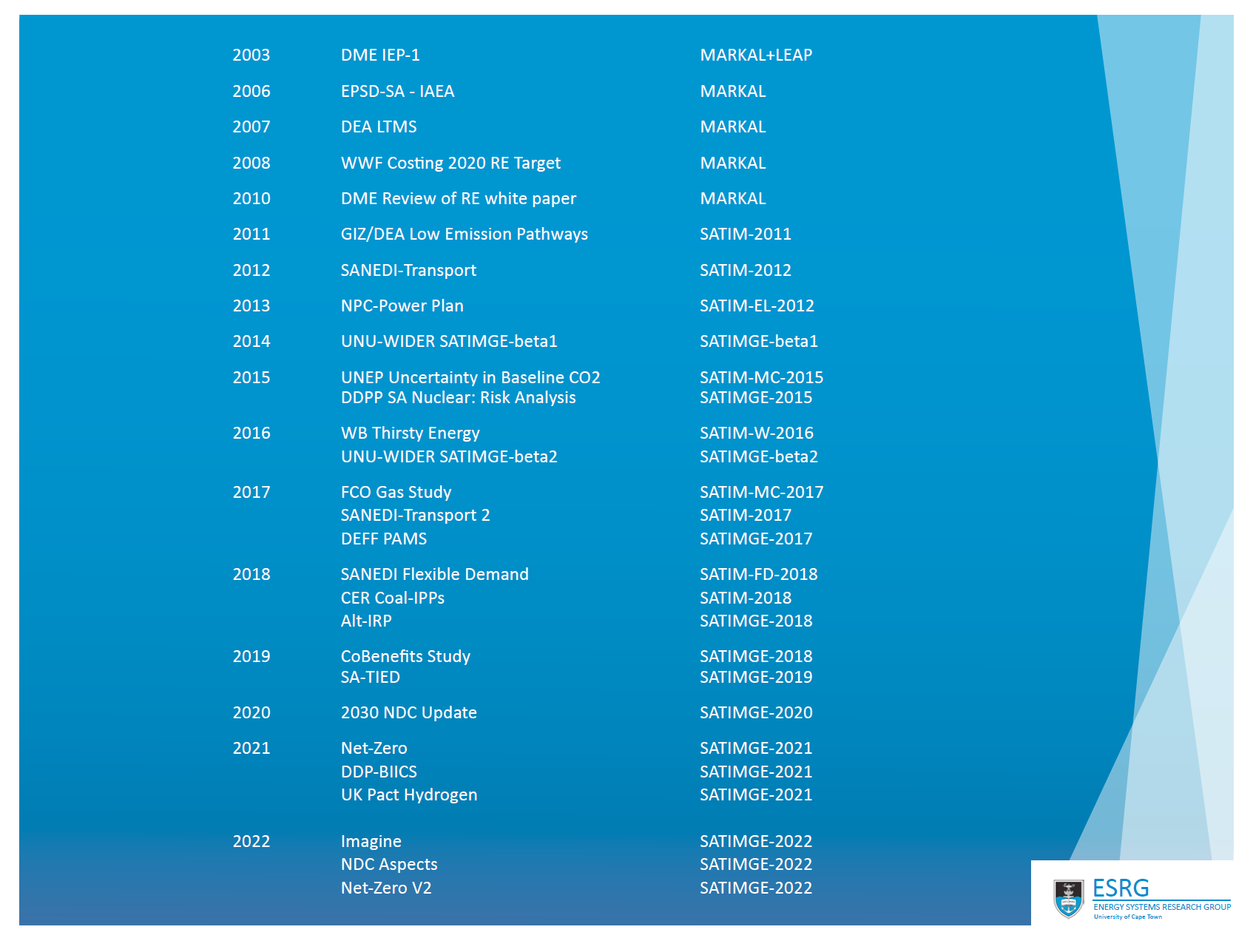
How has SATIM and now SATIM-GE been used
Power sector
Demand sector
Interactions - EEDSM
Emissions – large focus since 2006
Economic impacts of different pathways to reduce emissions
New technologies
New fuels
New policies
-2023
Tsitica, SARB, CCDR, JETP
SATIMGE-2022
Notes:
Long history of running energy systems models in the ESRG/ERC/ERI
The model has become more complex over time
Initially power sector
As the model has become more complex it relies on submodels
As the model has become more complex the range of scenarios and the diversity of what you can interrogate in the energy system has increased
E missions – large focus in recent years,
With SATIM GE can look at economic impacts of emissions pathways

Slide 9
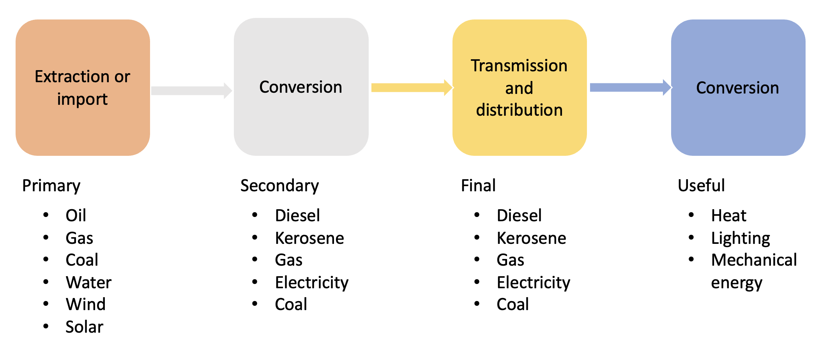
Representation of the energy system in ESM
Demand

Slide 10
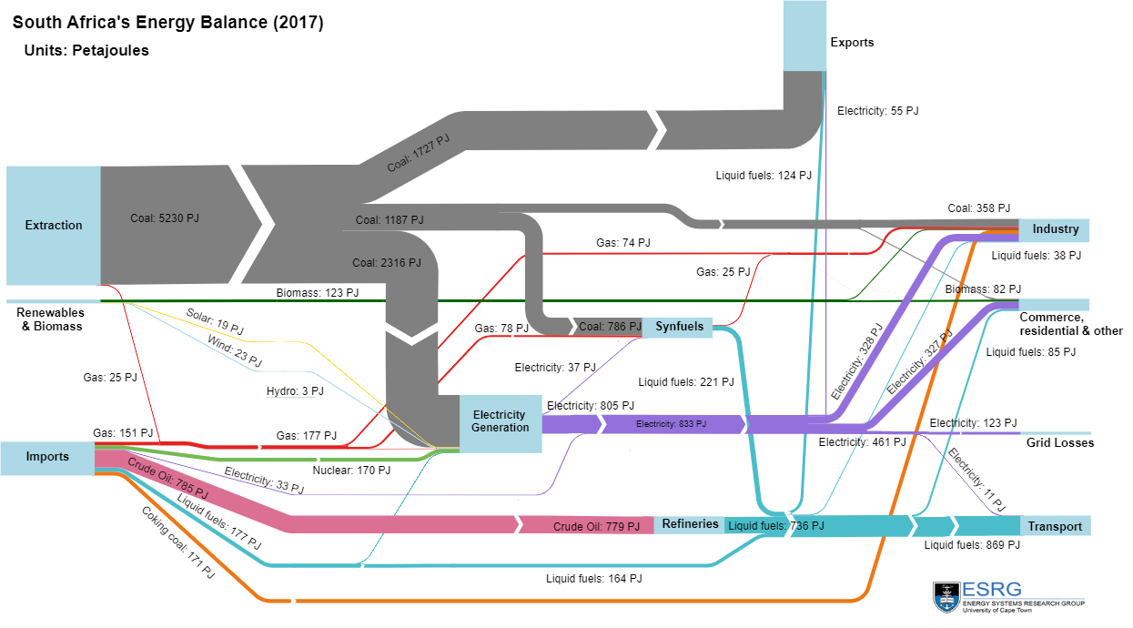
Structure – what components of the energy system does SATIM capture
Notes:
Extraction
Imports
Exports
Electricity production
Liquid fuels production
Demand by sector
In the base year fuel consumption matched to an energy balance – adjusted eg in residential based on what we know as well as sometimes to better represent the distribution of energy use in the system

Slide 11
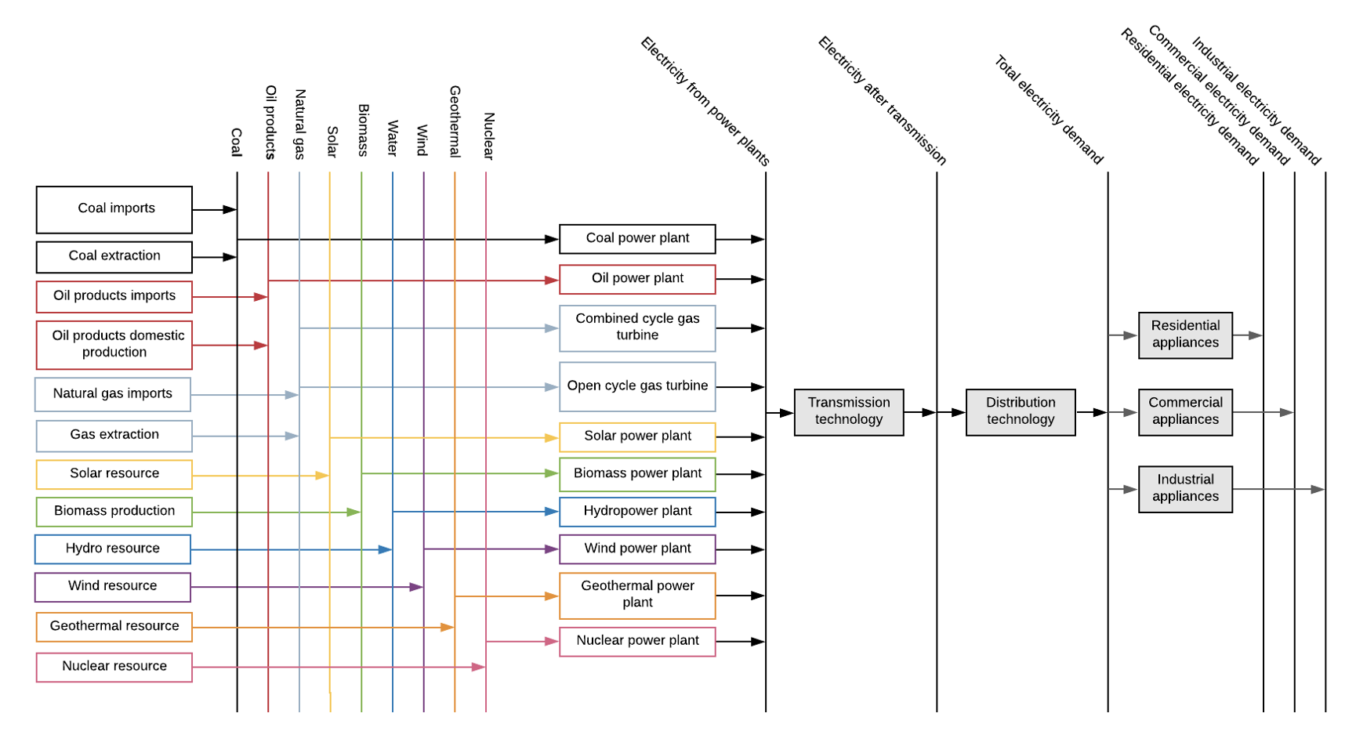
Structure -how does SATIM depict the SA energy system
Representing flow of energy/emissions/materials
Defining
Input to a technology (single or multiple)
Output from a technology (single or multiple, energy and emissions)
Techno-economic characteristics of the technology eg efficiency, availability, cost, lifetime, etc
Data and structure link model to the real world-
Notes:
First : RHS is not satim but it shows an example of what we call a RES – boxes are processes/technologies and lines are commodities
First bullet: Res represents the flow of energy/ emissions through the system : built to be energy system specific,
Shows how processes produce fuels, losses in the system can be accounted for in processes, demand is featured on the RHS, and the system is structured so that demand can only be met by certain processes, certain processes use certain fuels, certain processes produce certain fuels
Third bullet: Process information covers things that are important in the optimisation

Slide 12
Notes:
Within SATIM there are supply sectors (extraction, electricity, liquid fuels (including biomass and hydrogen) and
five demand sectors (industry, agriculture, residential, commercial, and transport).
There are also imports and exports
Each sector is further disaggregated into subsectors as appropriate.
Demand and supply are calibrated to the base year energy balance
Demand sectors have Useful energy Demand or production of a commodity
Demand drivers and policy objectives Very important for IEP
By including a detailed representation of both the supply and demand sectors in SATIM it is possible to explicitly capture the impact of demand side changes, such as structural changes in the economy (i.e., different sectors growing at different rates), process changes, fuel and mode switching, technology change and efficiency gains in the supply side optimisation. It also allows energy sector emissions to be captured in full and allowing combined supply and demand side targets to be set.

Slide 13
Structure - Demand
Useful energy services in each sub-sector.
UED exogenously specified
This allows fuel substitution and technology improvements
These in turn influence the efficiency at which energy services are met,
FED is therefore endogenous
Varying level of detail on each demand sector
Number of subsectors
Number of technologies
Number of energy services
etc
FED
LPG
FED electricity
UED – water heating
EL Geyser
Heat pump
Gas Boiler
Notes:
The level of detail in which each sector is modelled in terms of sub-sector, technology and energy service disaggregation is often a reflection of the relative contribution of the sector to total consumption, but it is also a reflection of the level of funding that has been available for developing a sector in the model.

Slide 14
Sector and Sub-sector representation
Sector | Subsector Disaggregation | End use Disaggregation
Agriculture | None | Irrigation, heating, processing, traction, other.
Residential | High, medium and low-income households | Cooking, water heating, space heating and cooling, refrigeration, lighting, other electric usage
Commercial | None | Cooling, space heating, cooking, lighting, refrigeration, water heating, public lights, public water
Industrial | Iron and Steel, Ferroalloys, Non-metallic minerals, Platinum Group Metals, Aluminium, and Pulp and Paper | Tonnes produced by Industrial processes
 | mining, chemicals, food beverages and tobacco, precious, and non-ferrous metals, and general manufacturing | Boiler and process heating, cooling, HVAC, lighting, fans, pumping, compressed air, electrochemical and other electrical services
Transport | Air, Freight and Pipeline | Freight tonne km by rail and road (1 light vehicle class, 9 heavy vehicle classes)
 | Private passenger | Passenger kilometre travel by Cars, SUV, motorbikes
 | Public passenger | Passenger kilometre travel by Bus, train, minibus, BRT
Notes:
Quite a lot of difference in each sectors representation, including the drivers
Go through each line by line

Slide 15
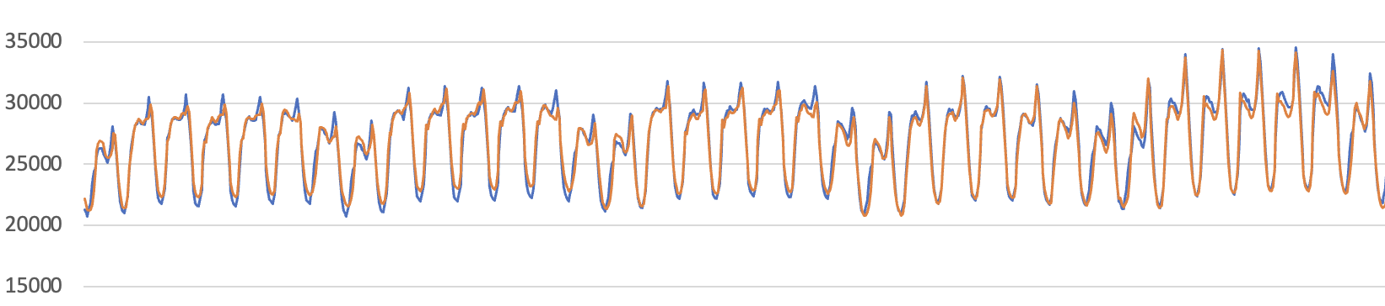
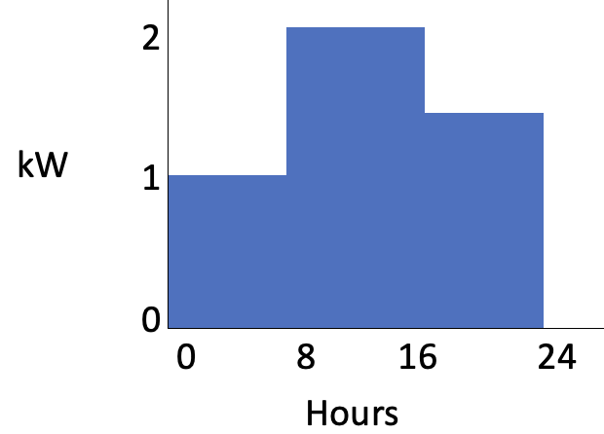
Structure – why is time of use important, where is it captured, and to what extent
SATIM uses intra day/year temporal resolution
Timeslices - Term to denote the sub-annual chunks of time used to represent the demand for electricity (load profile) and resource availability (RE/Hydro)
Very crudely
Timeslices are user defined , number of hours, days, years is entirely flexible
Typically set up to capture winter and summer to better capture changes in peak demand.

Slide 16
Timeslices in SATIM
Various versions with different resolutions
Higher resolution allows us to capture electricity sector adequacy in more detail
Also allows us to better capture DSM response interactions with the supply side
There is a large computational cost to increasing timeslices – especially over longer term models – ways to overcome these costs – hybrid system where higher resolution checks are performed using dispatch models.
All the load profiles include a morning and evening peak and night time period with lower average demand.
Base year
Calibrated to represent national demand by sector
Calibration done for 8760 hours (2017)
Calibrated to subsector and end use
The load profile will change over time responding to
Sector shifts
Fuel switching
Technology changes – efficiency
New Demands
?

Slide 17
TOU sector/sub-sector calibration

Slide 18
Structure – what about the future
Linked model SATIM-GE
Demand drivers drive UED
UED must be met
In Scenarios GDP typically changes but population growth is always the same
CGE provides internal consistency between sectors and economies response to changes in the energy system
Scenarios can incorporate changes to bounds–constraining fuel use/technology deployment/costs/new technologies/technology characteristics eg efficiency/other levers /UED adjustment (due to eg behaviour)
Policy levers – taxes, subsidies, emissions constraints
Notes:
Scenarios you are changing something in the system-

Slide 19
Demand drivers in SATIM
Sector | Subsector Disaggregation | Useful Energy demand Driver
Agriculture | None | Sectoral GDP
Residential | High, medium and low-income households | Population, Household-income, electriﬁcation rate
Commercial | None | Sectoral GDP, building stock
Industrial | Iron and Steel, Ferroalloys, Non-metallic minerals, Platinum Group Metals, Aluminium, and Pulp and Paper | Sectoral GDP
 | mining, chemicals, food beverages and tobacco, precious, and non-ferrous metals, and general manufacturing | Sectoral GDP
Transport | Air, Freight and Pipeline | Transport GDP
 | Private passenger | Household income, population, vehicle ownership, etc… see transport section below
 | Public passenger
Notes:
Sector growth – GDP linked to production and consumption of goods, commercial activity and floor area, freight transport
Household income and expenditure/ Passenger transport –GDP/population

Slide 20

Emissions
Combustion, industrial process emissions, fugitive emissions
Emissions are accounted for at the source
They are related to output
We do not account for AFOLU and waste

Slide 21
Data – what data and where does it come from
Data stress – is real
Energy consumption and production – Energy balance
Resource costs
Technology data – efficiency, availability, cost,
Emissions factors
System constraints
SATIM Energy balance
calibrated based on, but not that of, the DMRE
Electricity
Wood and coal use by households
Data sources –
Everything we can get our hangs on : StatsSA – Social accounting matrix/income and expenditure surveys/travel survey/general household survey/census/DMRE reports/Eskom reports/Company reports, papers, personal contact
Estimates
South Africa lacks empirical studies – eg how have building standards influenced consumption?

Slide 22
Deeper dive into sectors

Slide 23
Electricity production
Electricity must meet TOU demand – Peak demand as well as
Covers Generation, transmission and distribution
Power plants are individually represented i.t.o, capacity, availability, capacity factor, conversion efficiency, fixed and variable operating costs, and life, including expected decommissioning years
New build options include imports, nuclear, wind, solar PV (grid and rooftop), solar thermal plants, coal, diesel and gas, hydro, pumped storage and battery technologies.
Reserve margin – technologies can be excluded from contributing to the reserve margin,
SATIM takes a fairly conservative approach, PV, solar thermal plants without storage and wind excluded from contributing to the reserve margin
Constraints applied to build rates overall or in a period to mimic real world concerns over potential limitations/ policy
Single node – transmission bottlenecks are not accounted for, transmission costs are weakly accounted for
Transmission losses are an average loss
Distribution losses are sector specific
Both transmission and distribution losses are accounted for in the TOU calibration process
Notes:
Transmission expansion costs are modelled in two steps: Step 1 tracks peak demand, and has a higher investment cost per kW; Step 2 tracks the sum of installed capacity minus Step 1 capacity, and has lower cost. Step 2 accounts for grid expansions that are required to accommodate spatially diffuse installations of generation that extends beyond peak demand.
Residential and agricultural losses are assumed to be higher, than commercial sector and light manufacturing, and lower for heavy manufacturing which generally “connects” to the grid at a higher voltage. Investment and maintenance costs follow the same logic.

Slide 24
Simplified power system RES
Residential Electricity
U₂₃₅
Distribution to Residential
Nuclear Plant
Pumped Storage
Coal
Heat to Industry
Coal Plant
CoGen
Diesel
OCGT Plant
Industrial Electricity
Transmission
Distribution to Industry
Hydro Plant
RE
Distribution to Commercial
Solar/Wind Plant
ELCC
ELC
Commercial Electricity
GENERATION
TRANSMISSION
DISTRIBUTION
Notes:
Technologies that lie within the transmission and distribution network are pumped storage, cogeneration and distributed renewables. Losses in the transmission of electricity to and from these technologies is accounted for as follows:
Pumped storage stations lie between generation and distribution. They use electricity distributed through the transmission grid and feed electricity back into the transmission grid, these plants therefore incur transmission losses twice.
Cogeneration occurs after transmission and electricity is fed into the distribution grid to meet industrial electricity demand. The heat generated is used to meet industrial heat demand.
Distributed energy technologies built within a sector such as embedded solar or storage are not subjected to distribution losses and are currently not able to feed electricity into the central network to reach the other sectors.

Slide 25
Liquid fuels production
Captures all currently produced commodities
Imports and exports
Crude oil refineries, synthetic fuels, biofuels (ethanol and biodiesel)
Product slates are refinery specific, new refineries can accommodate varying product slates
Steam into synfuels plants is modelled as an ancillary service supplied by boilers allowing the boiler fuel and technology to be optimized
Notes:
Commodities produced by the South African liquid fuels sector at present are petrol (gasoline), diesel, kerosene (jet fuel / illuminating paraffin), aviation gasoline, liquid petroleum gas (LPG), heavy fuel oil (HFO) and methane-rich gas (produced by the synthetic fuels industry only).
The inland crude refinery has a more diesel- and kerosene- heavy product distillate, and the two synthetic refineries have a gasoline-heavy distillate, thus they are characterized separately in SATIM. Product slates are modelled by applying an assumed upper bound output commodity share for each commodity.

Slide 26
Simplified liquid fuel RES
Oil
Refineries new and exiting
HFO (Ag, Com, Ind, Tra)
Electricity
Electricity
Gasoline (Ag, Com, Ind, Tra)
GTL
new and exiting
Oil
Diesel (Ag, Com, Ind, Tra, Power)
Gas
Kerosene (Ag, Com, Res, Tra)
Electricity
CTL
new and exiting
Coal
LPG (Ag, Com, Ind, Res)
Gas
Steam
AvGas (Tra)

Slide 27
Demand sector deep dive
To Recap : Each demand sector within SATIM is governed by a number of parameters and general assumptions relating to
(a) the base year demand for energy by fuel type;
(b) the structure of the sector and its energy service needs;
(c) technical and cost parameters of the technologies available to satisfy the demand for energy services in the base year and over the model horizon and;
(d) the demand for energy services over the planning horizon.
Residential / Commercial/ Transport/ Industry/ Agriculture

Slide 28
Residential Sector

Slide 29
Basic structure
Drivers – population/households (exogenous), income shifts (endogenous)
Income relates to both fuel use/choice and the level of energy services accessed
Electrification - exogenous
Multiple fuels – includes wood, coal, paraffin, gas, electricity - quite constrained
Aggregate energy efficiency of meeting an energy service with a particular fuel
Exception is water heating where SWH’s/Heat pumps/Resistance water heating represented separately
Stocks define efficiency –
Stock turnover and expected efficiency of replacement stocks defines average efficiency
TOU for all energy services in each income group
Households are a large portion of the peak (estimated up to 35%)
Level of intensity of energy services, technology efficiencies and fuels used are defined for each income group

Slide 30
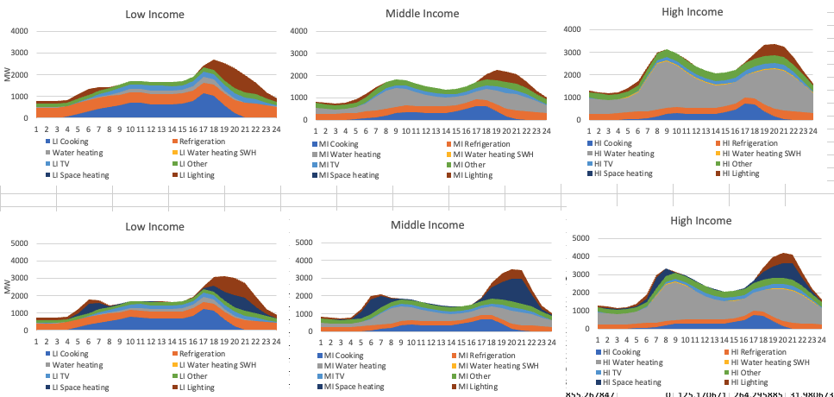
TOU representation in the Residential Sector

Slide 31
Household response under Net-Zero
Constrained by assumptions around access to electricity
Equally it is constrained by the policy support for access to efficient appliances, subsidized electricity or households ability to pay, housing policies etc
It is helped by upward income mobility
Unmeasured policy impacts that need to be estimated – eg SANS10400
Demand side responses related to energy efficiency can improve both supply costs and the cost of accessing energy services in low income households
Behaviour response is important but difficult to quantify and typically not modelled

Slide 32
Commercial Sector

Slide 33
Basic structure
Private and public sector buildings and street lighting and water treatment plants
Drivers – square meters of buildings- growth in floor area linked to historic trends – slight lag – energy intensity of energy services linked to floor area (PJ/m²)
Energy service demands can be met by
Multiple fuels
Multiple technologies
Captures energy service needs in new and existing buildings
Building stocks linked to demand for energy services–
Newer buildings have lower UED
TOU for all energy services
Commercial use higher over the day
Buildings can respond to net zero constraints by fuel switching and adopting higher efficiency technologies, it is also possible to force in stricter building regulations that lower UED
Notes:
New commercial floor space is assumed to have both more options in terms of the adoption of energy efficient technologies for energy services such as space heating, as well as a lower demand for useful energy services. This disaggregation accommodates efficiency improvements over time as building codes mandate improved building standards and new technologies replace older more inefficient technologies.

Slide 34
Transport Sector

Slide 35
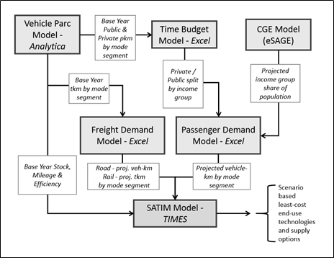

Slide 36
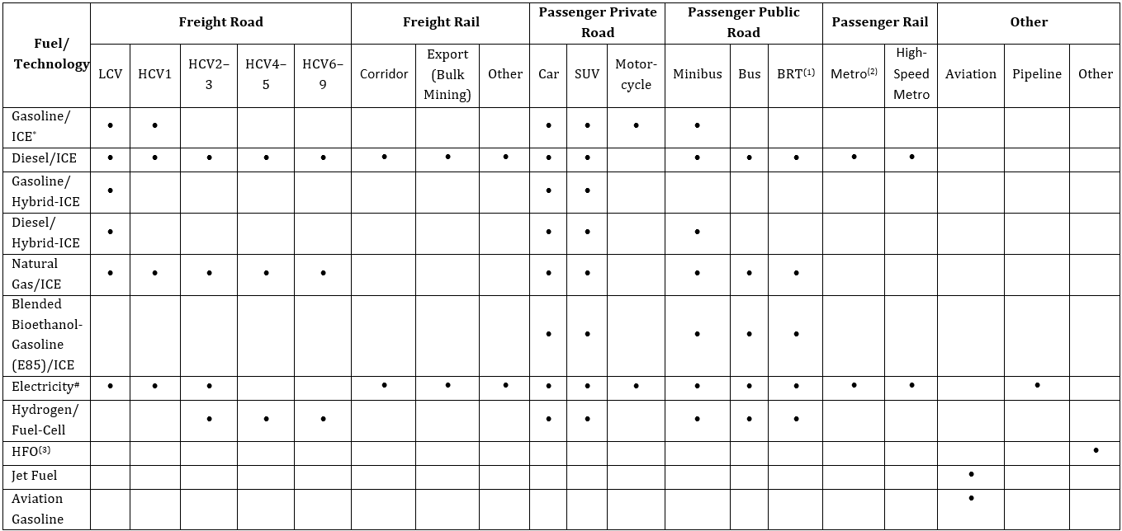

Slide 37
Industry Sector(s)

Slide 38
Approach to modelling
Based on two things: access to data, intensity/scale of industry types
Two methodologies employed within SATIM sectors;
For more numerous industries, often not energy intensive - model based on higher level energy data like energy balances (methodology 1)
Energy intensive industries – fewer, generally more energy intensive facilities (methodology 2)
Drivers are from sectoral GDP growth from economic model
Methodology 1 – GDP growth adjusts the enduse service (e.g. process heat)
Methodology 2 – GDP growth adjusts how much output (e.g. Mt of steel)

Slide 39
Industry sector characteristics and methodology
 | Sectors | Description/comment
Methodology 1 | Food and beverage
 | General Manufacturing
 | Chemicals* | Just the energy use for chemical production, excludes SASOL almost entirely
 | Mining | Excludes PGM mining
 | Precious and other Non-ferrous | Excluding aluminium and PGMs
Methodology 2 | Iron and steel
 | Non-Mettalic Minerals | Cement, Lime, Glass, Bricks
 | Pulp and Paper
 | Ferro Alloys | Chrome and Manganese
 | Aluminium
 | PGMs

Slide 40
Electricity
CEMENT RES for SATIM in NZ project
Gas
Biomass
Coal
Waste
CO2
CO2
To atmosphere
Kilns
Heat
CCU/S
Long dry
NS preheater
NS preheater + pre-calciner
New kilns
Roller press
Clinker
Roller press
Cement
Ball Mill
Ball Mill
Raw Material prep
Fly Ash
Finish grinding
BF ground slag
Substitutes
Gyspum + limestone
National aggregate clinker substitution
Clay
From Blast furnaces
Natural Pozzolana

Slide 41
Iron and Steel in SATIM
Hydrogen based steel
H2 storage
Iron storage
Exports
Electrolyser
DRI
EAF
Existing technologies
BF-BOF
Electricity (grid)
DRI-EAF coal
Scrap-EAF
MIDREX-CONARC
KILN-EAF
Energy efficiency improvements
Steel
Coke oven
Coking coal
Coke oven (new)
New technologies
Coal
BF-BOF (New)
Gas
DRI-EAF coal (New)
Oil products
DRI-EAF gas (New)
Scrap-EAF (New)
Biomass
Waste fuels

Slide 42
Enduse energy service shares for M1
Mostly based on EIA data/surveys for the US.
Couple to energy balances ~ estimate for energy use by fuel for service
Generally, coal, gas, oil/HFO, or other fuels are process heat, electricity use the tricky one.
End-use Fractional Shares by Sub-sector | Demand ID | Mining | Chemicals | Nonferrous | Food and Beverage | Others
Elec Heating | K | 2.0% | 2.0% | 1.0% | 7.0% | 9.7%
Compressed air | A | 18.6% | 15.0% | 0.0% | 4.0% | 10.9%
Lighting | L | 4.5% | 4.0% | 1.0% | 5.0% | 8.1%
Cooling | C | 8.1% | 5.0% | 0.0% | 23.0% | 5.1%
HVAC | H | 8.0% | 2.0% | 1.0% | 6.0% | 8.5%
Pumping | P | 17.9% | 35.0% | 0.0% | 28.0% | 13.0%
Fans | F | 6.9% | 8.0% | 0.0% | 4.0% | 5.5%
Other motive | O | 33.8% | 20.0% | 7.0% | 21.0% | 36.9%
Electrochemical | E | 0.2% | 8.0% | 90.0% | 0.0% | 1.3%
boiler/process heating | S | 0.0% | 1.0% | 0.0% | 2.0% | 1.0%
Non-Energy Use | T | 100.0% | 0.0% | 0.0% | 100.0% | 200.0%
Transport | R | 18.6% | 13.0% | 4.0% | 10.9% | 1.0%
Total |  | 219% | 113% | 104% | 211% | 301%

Slide 43
Issues with Industry modelling
Access to data in South Africa is difficult
Especially if working for government
Businesses are struggling
Industries do many things in one place – data difficult to seperate
E.g. PGM mining and refining

